Slide 1






Lecture 33:
Navigation
Course - Web Development - II
-By
Instructor Name
welcome@krmangalam.edu.in
Sohna Road,Gurugram,Haryana 122103

Slide 2

| Table of Contents
NavLink Active State (isActive)
Styling Active & Hover Links
useNavigate Hook
References.
The End.

Slide 3

|
So far, we created navigation using Link and NavLink, But how do users know which page they are currently on? Also, how can we redirect users automatically after some action like login or form submission?

Slide 4
|
Just like on Amazon or Instagram
The current page is always highlighted
Sometimes, users are automatically redirected
In React Router, we solve this using:
NavLink (isActive) → To highlight active link
useNavigate Hook → To navigate programmatically

Slide 5
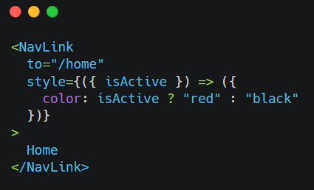
| NavLink Active State (isActive)
NavLink provides a way to style active links automatically.
It gives a special property: isActive
Helps identify current route
Used to apply custom styles

Slide 6
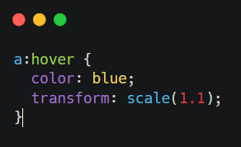
| Hover Effect in NavLink
We can also add hover effects to improve UI
Makes navigation more interactive
Combine hover + active → Better user experience

Slide 7
| useNavigate Hook
useNavigate is a hook used for programmatic navigation
It allows navigation using JavaScript
Use Cases:
After login → redirect to dashboard
After form submit → redirect to success page

Slide 8
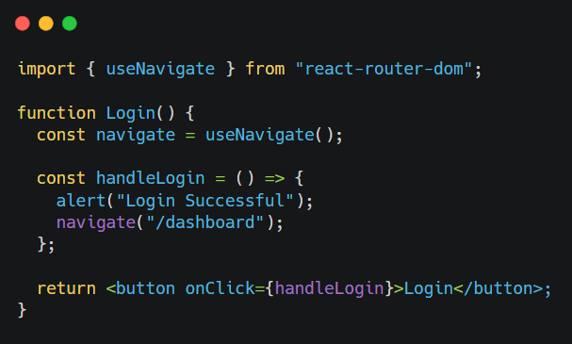
| useNavigate Hook

Slide 9
| Real-Life Analogy
No need for Link — navigation happens via function
Think of it like:
NavLink (isActive) → Highlight current tab (like YouTube Home button)
useNavigate → Automatic redirection (like after payment → success page)

Slide 10

| Coding Questions
Create a navbar with:
Home
About
Contact
Task :
Highlight active link
Add hover effect
Redirect to another page using button

Slide 11
| References
MDN Web Docs : Comprehensive and official documentation for JS. 🔗https://developer.mozilla.org/en-US/docs/Web/JavaScript
W3Schools – JS Tutorial : Beginner-friendly JS tutorials with examples and interactive editors. 🔗 https://www.w3schools.com/js/
react.dev - A comprehensive, tutorial-style website that deeply explores core React concepts, including components, state, effects, and hooks, through interactive examples and in-depth explanations.
🔗https://react.dev/

Slide 12
Thanks
For
Watching
Course - Web Development - II
welcome@krmangalam.edu.in
Sohna Road,Gurugram,Haryana 122103

